Slide 1
First Order Logic
in AI
Designed for Rookies.

Slide 2
HI!
I am K-gen, I am a passionate programmer and a music enthusiast. In my free time, I like to play CS 2, and read books.

Slide 3
Logic?
What is meant by Logic?

Slide 4
Why do we need logic?
Why?
Notes:
Logic allows us to express very complicated and big things (like modelling the world knowledge) by using kind of formulas.

Slide 5
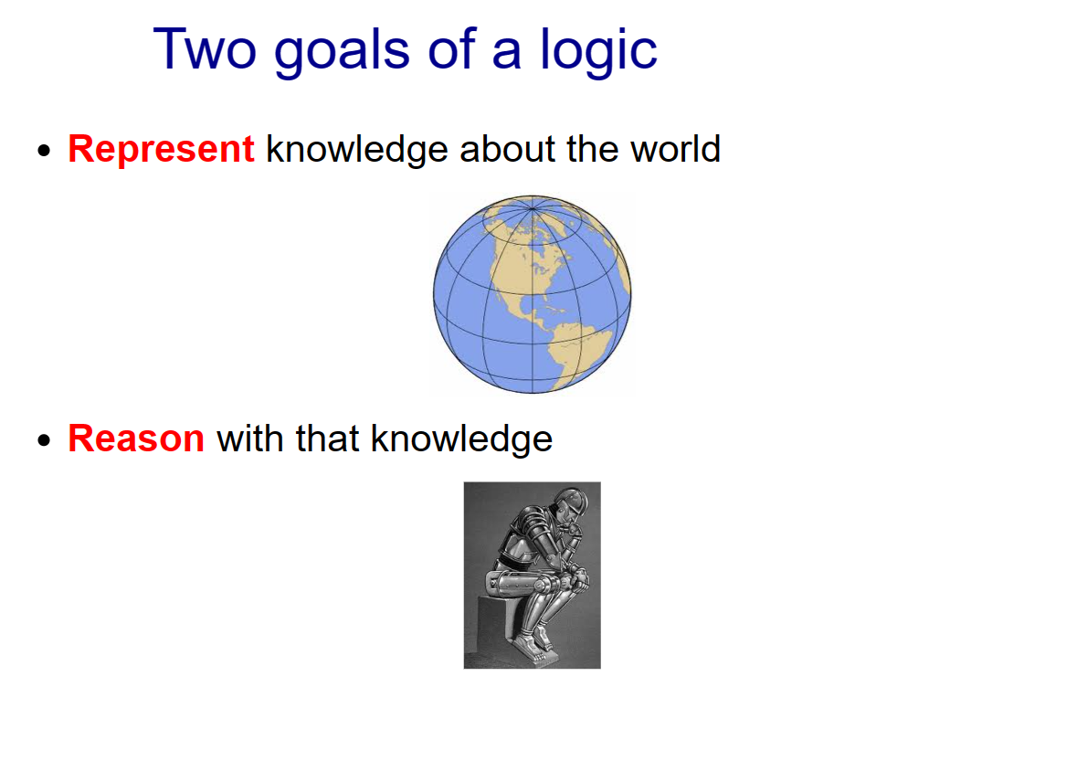
Notes:
Even hardware can represent the knowledge but we have to use that knowledge in a way to reason with it.

Slide 6
Types of Logics
Propositional logic with only Horn clauses
Propositional logic
Modal logic
First-order logic with only Horn clauses
First-order logic
Second-order logic
Notes:
Today, we are briefly talking about Propositional Logic, and bring the focus on FOL why PL is not enough

Slide 7
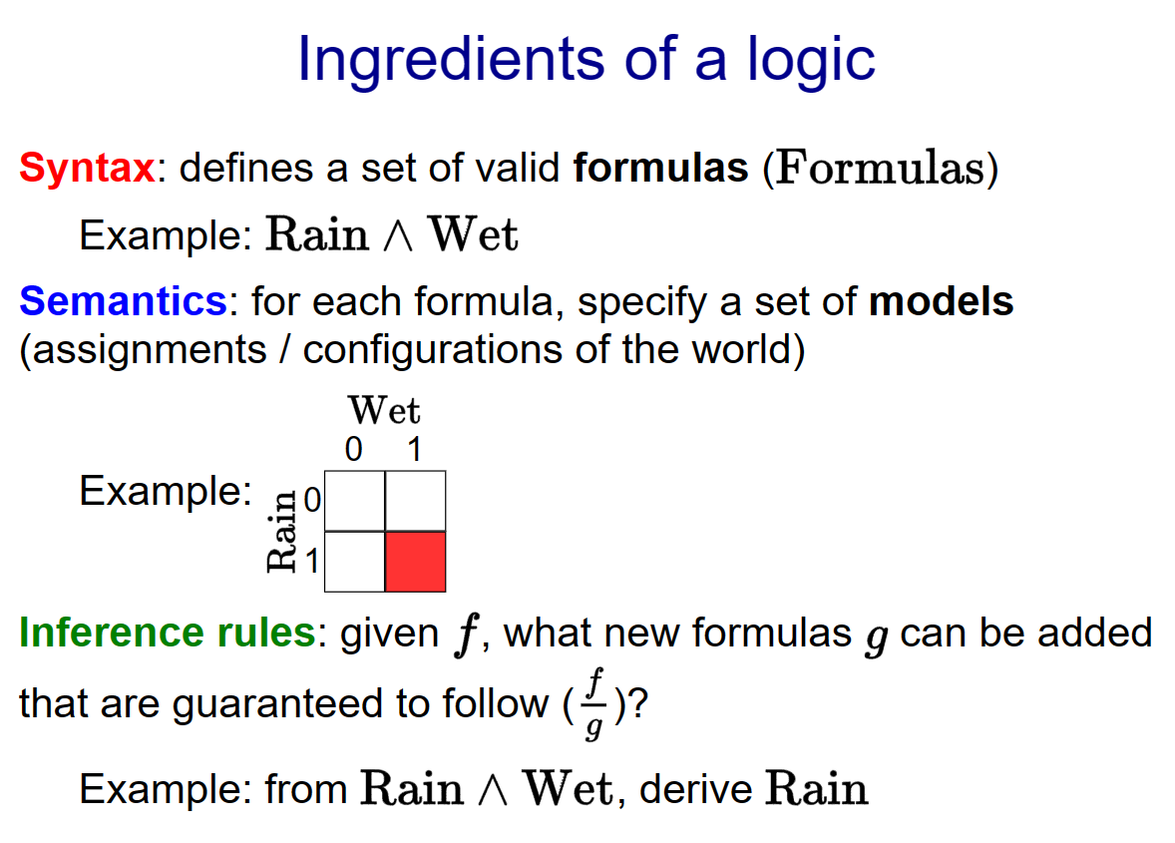
Notes:
Syntax means what kind of expression are valid. Semantics specifies the meaning of a formula.
Inference rules allow us to take various formula to do different thing. For example, if I tell you that it's raining and wet, then you should be able to conclude that it is also raining (obviously)

Slide 8
Syntax versus Semantics
Syntax: what are valid expressions in the language?
Semantics: what do these expressions mean?
Different syntax, same semantics (5):
2 + 3 ←—------------→ 3 + 2
Notes:
Even if they are two different syntax they represent the same semantics

Slide 9
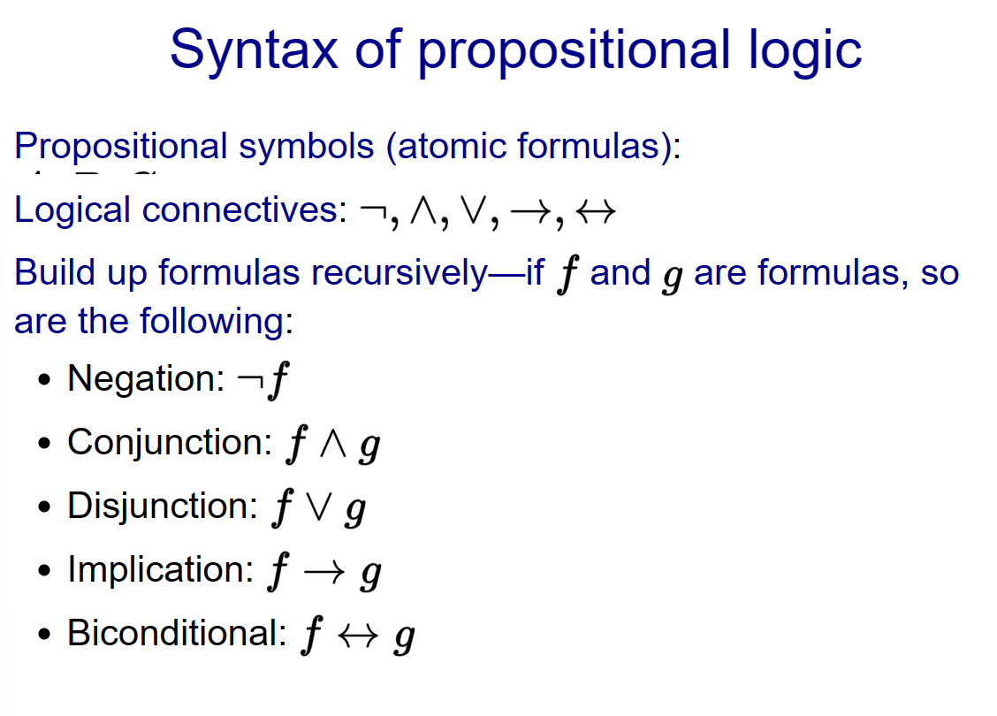
Notes:
These are some syntax in PL

Slide 10
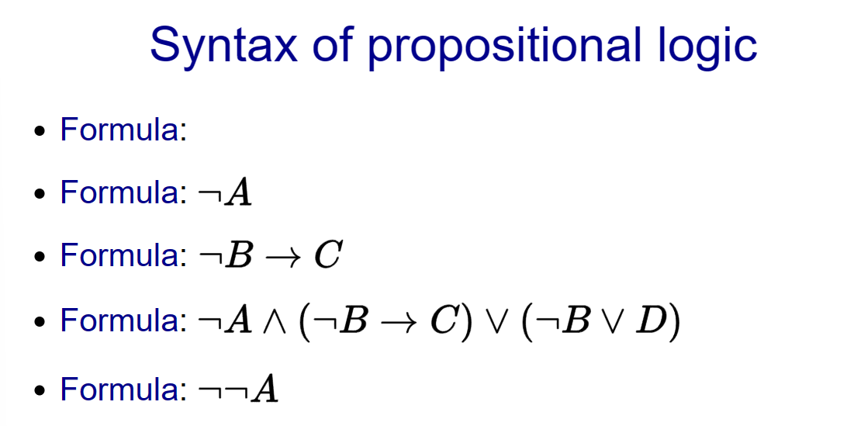
Notes:
And here are some formulas

Slide 11
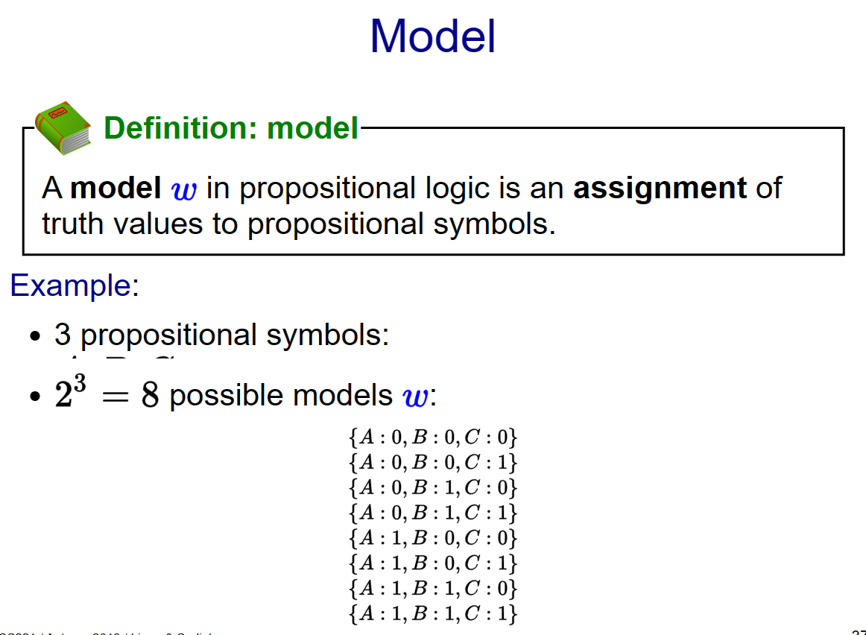
Notes:
A model (in the logical sense) represents a possible state of affairs in the world.

Slide 12
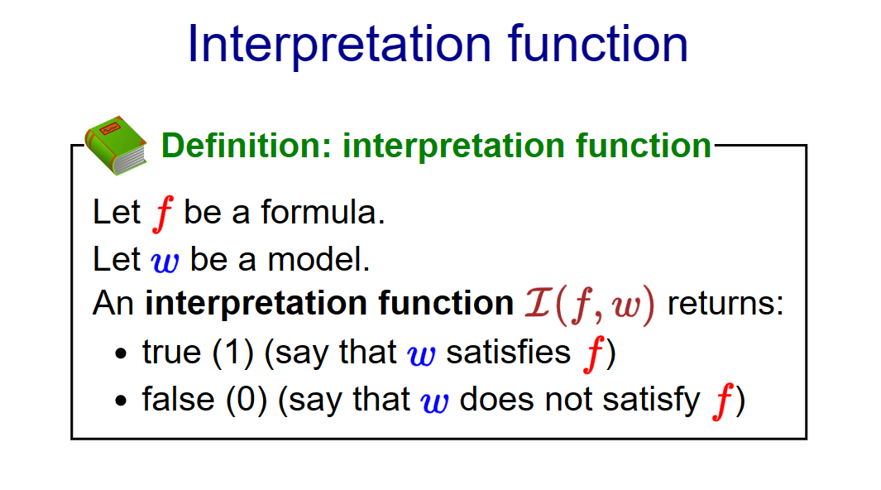
Notes:
It interprets the function to the model. For example, if f represents "it is Wednesday" and w corresponds to right now, then I(F,W) = 1 . If W corresponded to yesterday, then its 0 .

Slide 13
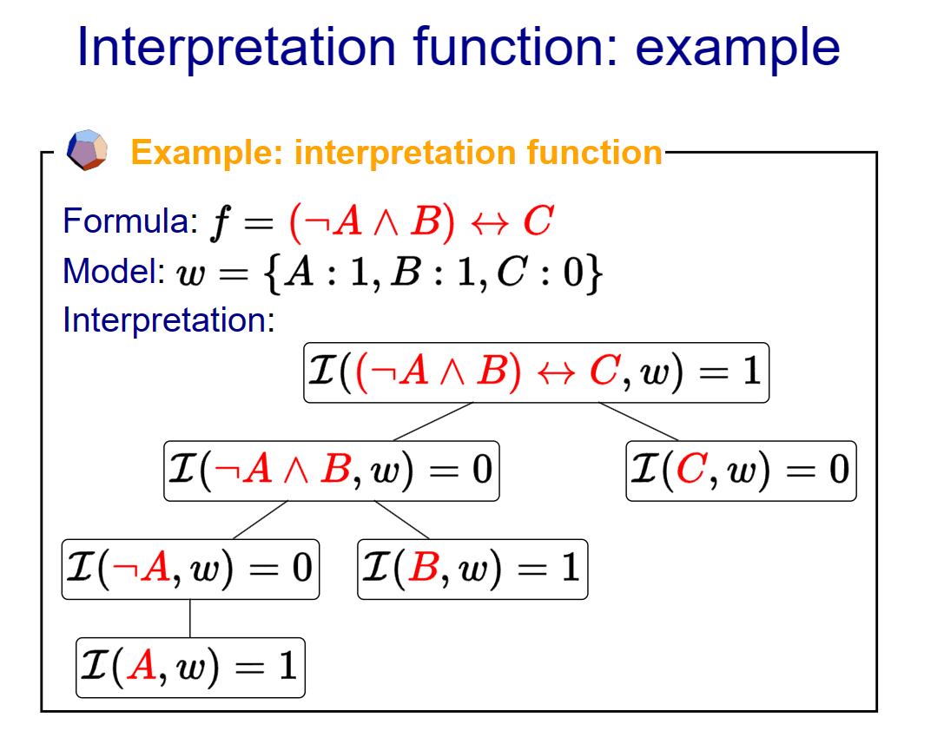
Notes:
These are just a syntax but we have not given any semantics to them.

Slide 14
Introduction
01
What is First Order Logic?
Notes:
Ok anyway lets start FOL, before understanding first order logic, lets understand zero order logic. This is my made up term but the meaning is true

Slide 15
Propositional Logic
Logic-based models: propositional logic, first-order logic
Applications: theorem proving, verification, reasoning
Think in terms of logical formulas and inference rules

Slide 16
Propositional Logic
It is a way to data representation in a logical form.
Such that:- TRUE or FALSE.

Slide 17
Propositional Logic
Propositional logic is declarative
Propositional logic has very limited expressive power
Propositional logic is compositional
Propositional logic allows partial/disjunctive/negated information(unlike most data structures and databases)
Meaning in propositional logic is context-independent(unlike natural language, where meaning depends on context)

Slide 18
First Order Logic
It is a robust technique to represent objects as well as their relationships. Unlike propositional logic, First Order Logic in Artificial Intelligence doesn't only include facts but also different other entities like objects, relations, functions.

Slide 19
First Order Logic
first-order logic assumes the world contains
Objects: people, houses, numbers, colors, baseball
games, wars, …
Relations: red, round, prime, brother of, bigger than,
part of, comes between, …
Functions: father of, best friend, one more than, plus,

Slide 20
Syntax versus Semantics
Syntax: what are valid expressions in the language?
Semantics: what do these expressions mean?
Different syntax, same semantics (5):
2 + 3 ←—------------→ 3 + 2

Slide 21
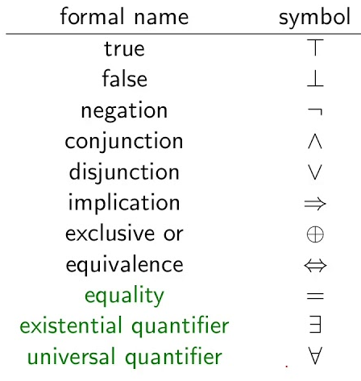

Slide 22
Symbol that I will discuss
Existential quantification
Universal quantification
∀
∃
∀x P(x)
∃ x P(x)

Slide 23
Universal Quantification
Universal quantification
"For all x, P(x) holds",
"for each x, P(x) holds" or
“for every x, P(x) holds"
"All CU CS majors should take an AI course." could be transformed into the
propositional form, ∀x P(x)
P(x) is the predicate denoting: x should take an AI course, where x represents a CU CS major.
This quantified expression asserts that for all x, P(x) is true.
∀
∀x P(x)

Slide 24
Existential quantification
Existential quantification
"There exists an x such that P(x)"
"There is at least one x such that P(x)"
"Someone hates Mac computers" could be transformed into the
propositional form, ∃xH(x)
H(x) is the predicate denoting: x hates Mac computers., where x represents all individuals..
This quantified expression asserts that there exists x, P(x) is true.
∃
∃xH(x)
Notes:
X can be me, professor V oy my friend Gio

Slide 25
Our First FOL
Example
Socrates is a philosopher. (This is an atomic sentence - -Propositional Logic)
If Socrates studies philosophy, then Socrates is a philosopher.
Socrates studies philosophy.
Therefore, he is a philosopher. If X studies PY, then X is philo. X studies pY Then X is philo

Slide 26
Our First FOL
Modus Ponens (I just studied about this in my PY101)
If X, then Y
X
Therefore Y.
Modus Tollens
If X, then Y
Not Y
Therefore Not X.

Slide 27
AI judging the text
If I input “K-gen is a philosopher. Is this correct?” Replies: I'm not familiar with K-gen as a philosopher.
If I input “K-gen studied philosophy, K-gen is a philosopher. Is this correct?”
Replies: If K-gen studied philosophy, then it would be accurate to say that K-gen is a philosopher.

Slide 28
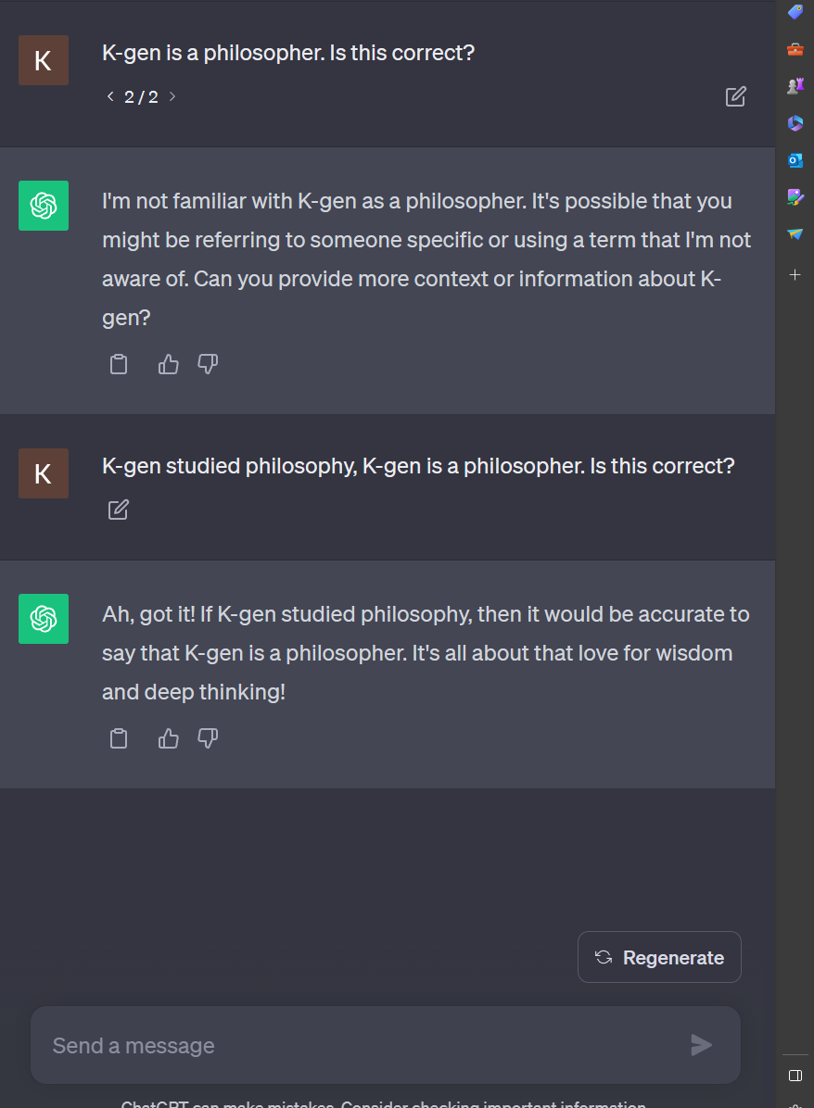
It didn’t require, how old is k-gen, what gender or anything but just the logic.
Notes:
Some people might think that, hey that is not programming, it is just a grammar fix, so it’s not very relevant. But wait, chat gpt itself is not grammar teacher, then how it knows. By this very algorithm

Slide 29
More FOLs
If X, then Y
X
Therefore Y.

Slide 30
More FOLs
P1: IF AI tries to harm humans, then we should shut them down.
P2: AI harmed the human.
Conclusion: Therefore, We should shut them down.

Slide 31

Just a picture I found online

Slide 32
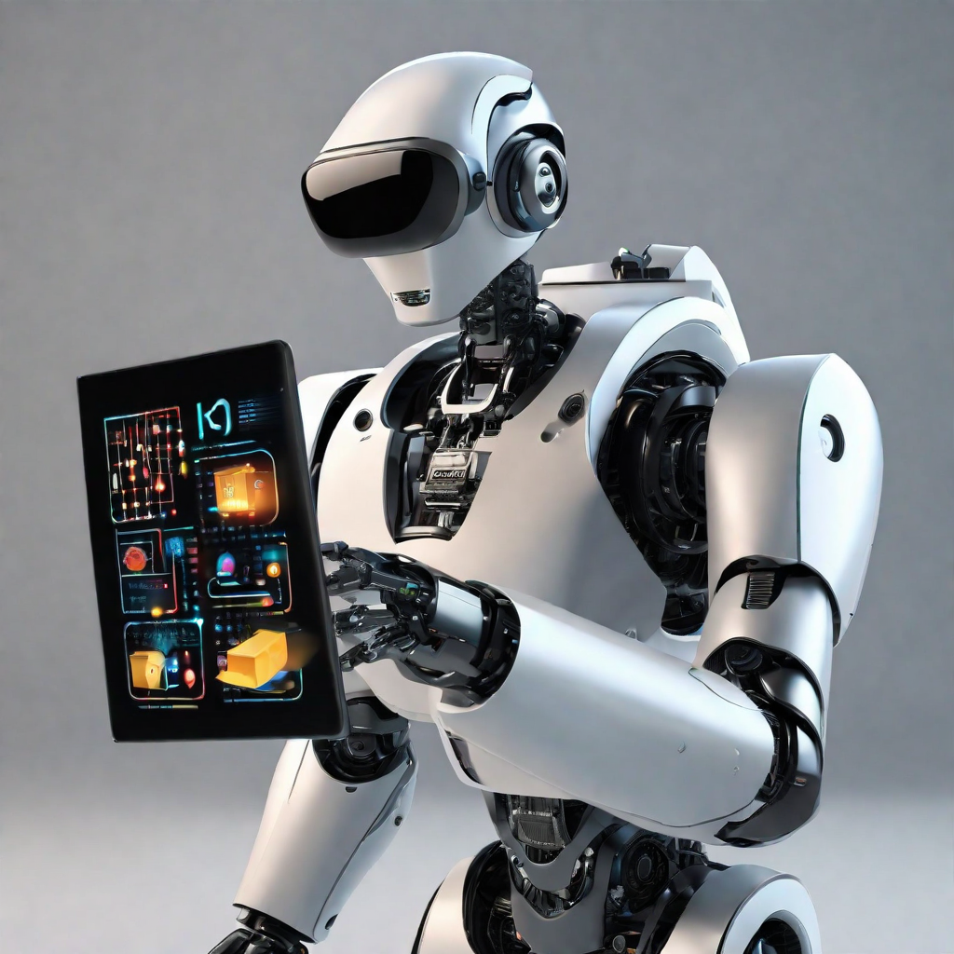
This one too.

Slide 33
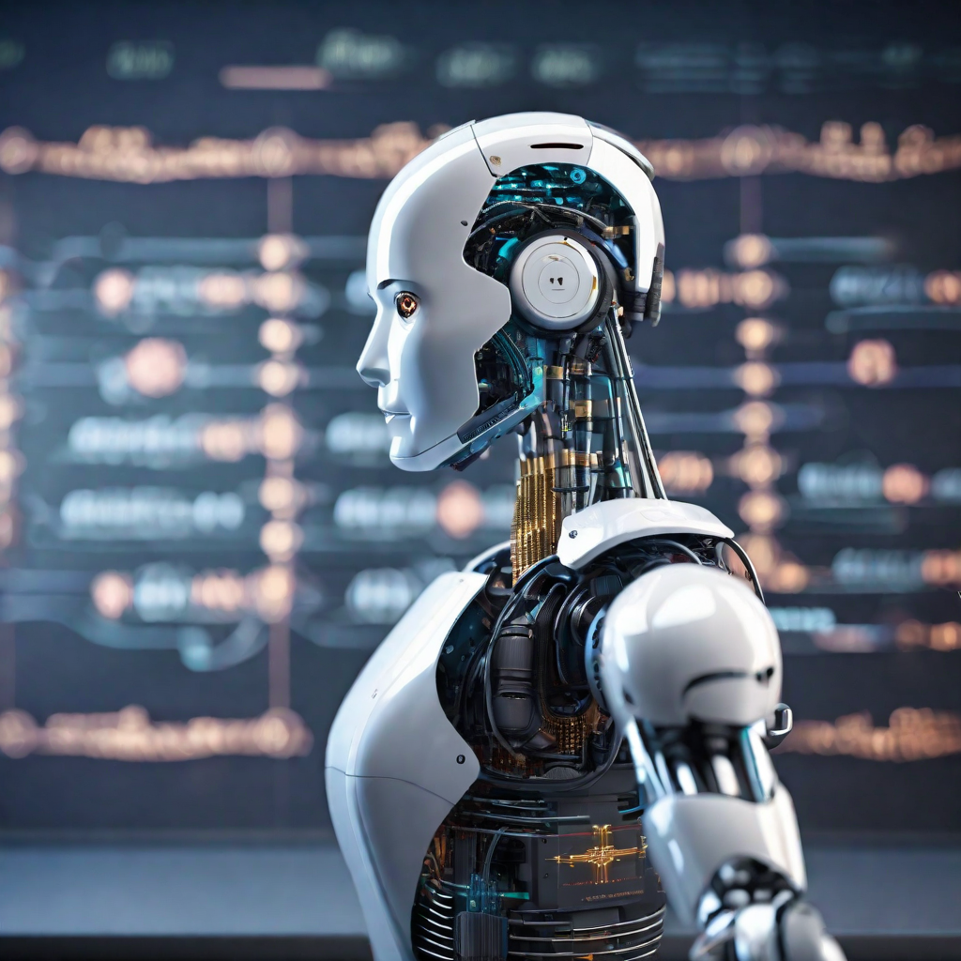
Last one…
Notes:
The reason I kept this picture here is, I feel amazed by looking at this robot.

Slide 34

Ethical/Social Issues
The major concern of AI

Slide 35
Ethical/Social Issues
Bias and Fairness
Transparency and Accountability
Privacy Concerns:
Job Displacement:
Security Risks:
Explainability:
others

Slide 36
Ethical/Social Issues
Bias and Fairness
Security Risks
The use of First-Order Logic (FOL) in AI systems may inherit biases present in the data used for training. This can lead to unfair or discriminatory outcomes, reinforcing existing social biases.
AI systems using FOL may be susceptible to adversarial attacks, where malicious actors manipulate input data to deceive the system. Ensuring robust security measures is essential to prevent unauthorized access and manipulation of AI models.

Slide 37
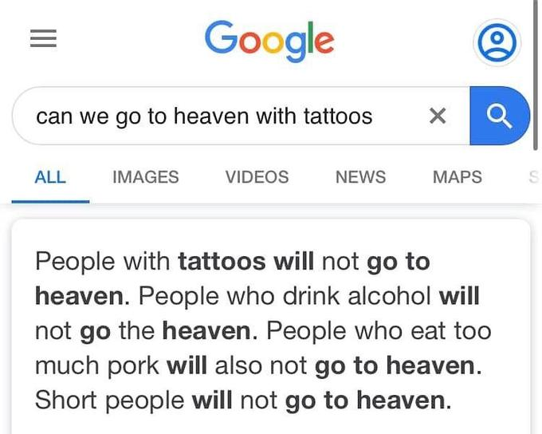
Notes:
Biasness like this causes too much problem, specially short people like me.

Slide 38
Economics and Company Profiles
FOL

Slide 39
Economics and Company Profiles
Economic Impact: The use of FOL in AI has significant economic implications. Companies adopting these technologies may experience increased efficiency, reduced operational costs, and improved decision-making. However, there may also be economic challenges, such as job displacement and the need for substantial investments in AI infrastructure.

Slide 40
Company Profiles
Google: Known for incorporating FOL in various AI applications, Google utilizes advanced logic systems to enhance search algorithms, language processing, and other services.
IBM: IBM employs FOL in its AI solutions, particularly in areas like healthcare and finance, demonstrating the versatility of these technologies across industries.
Amazon: Amazon's use of FOL is notable in its recommendation systems and logistics optimization, showcasing the impact on customer experience and operational efficiency.
Tesla: Tesla utilizes FOL in its autonomous driving technology, showcasing the role of logic-based AI in the automotive industry.

Slide 41
SWI-PROLOG
This is the tool that uses the concept of FOL.
Notes:
This is one of the top example to show the FOL demonstration

Slide 42
Simple, yet very powerful
https://www.swi-prolog.org/Download.html

Slide 43
Open source - GitHub
https://github.com/SWI-Prolog
Notes:
If you want to contribute then,

Slide 44
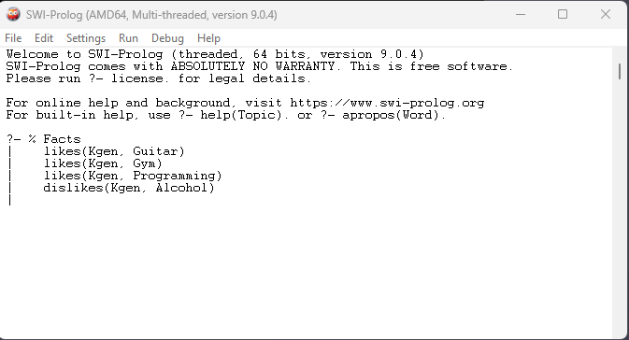
THIS IS A CLI

Slide 45
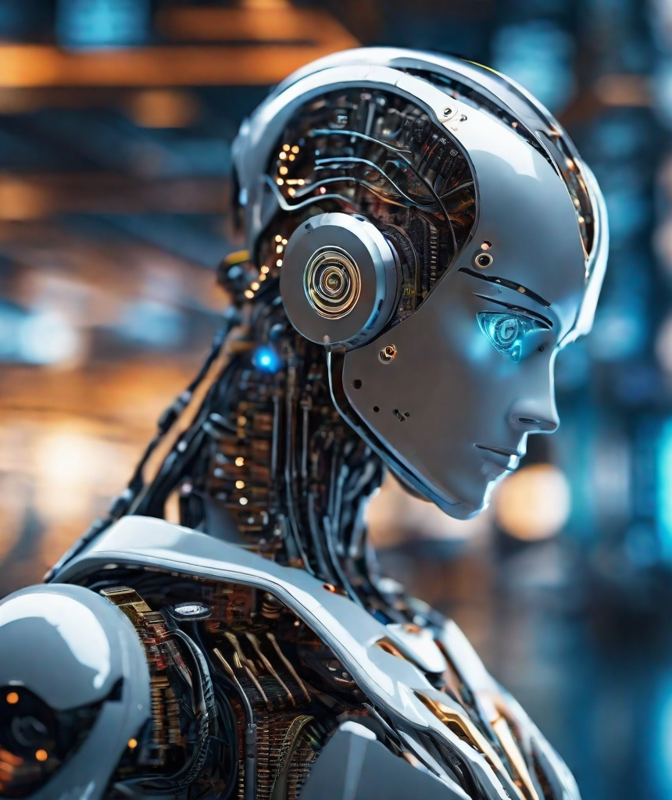
Ok, let’s see the real example
I will run the actual program where I have interpreted the meaningful examples.

Slide 46
IS AI this simple??
pending???

Slide 47
Nooo
nooooo!

Slide 48
Did we learnt fundamentals?
???

Slide 49
Yes, maybe!
yessssss!

Slide 50
So far we covered
Propositional Logic
What is FOL?
Modus ponens
Mathematical identifier
Ethical issue & Economics
SWI-PROLOG
And why it is limited to certain functions
Symbols & syntax
How to create one?
Universal & Existential identifiers
And how to manage them
How to download & How to use?

Slide 51
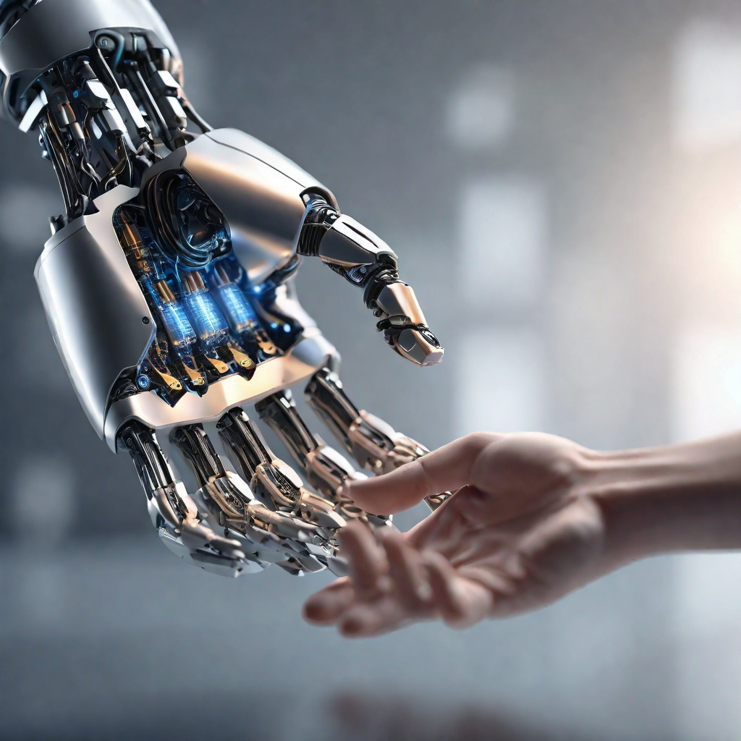
Summary
Propositional logic assumes world contains only facts.
first-order logic considers the world contains objects, relations, functions
Making modus ponens (If then therefore)
FOL consists of syntax & semantics
Learnt about existential & universal identifiers
Why Ethical/Social issues is concerning as well as economics & company profiles
Learnt about downloading and using the SWI-PROLOG
Notes:
Describe symbols and semantics

Slide 52
Head
Body
Tail
Learn about technical aspect
Learn about practical uses
???????

Slide 53
Questions please?
So, it is your turn to make my presentation plan complete by asking me questions.
Notes:
I will reply with best of my knowledge and ability

Slide 54
Fancy stuff isn’t gonna work, unless you learnt the fundamentals.
Randy Pausch
Notes:
A former professor in Carnegie Mellon, this has been stuck with me forever.

Slide 55

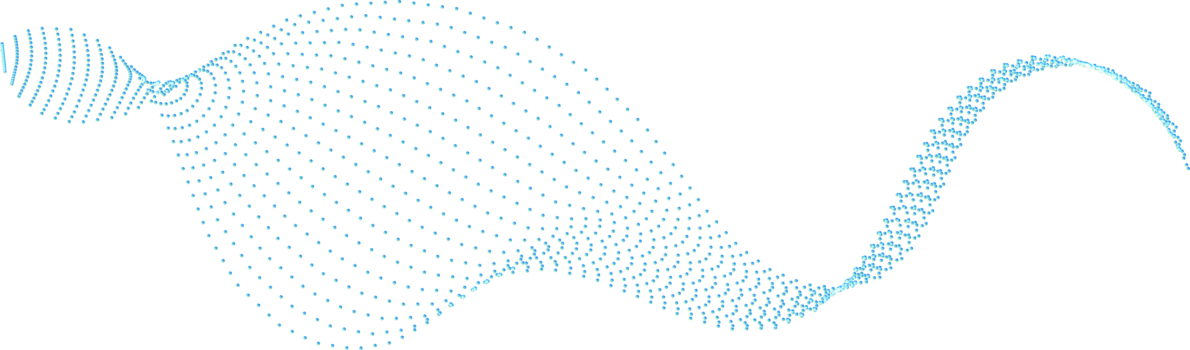


Thank You for watching
If you have any questions?
kkhatri@caldwell.edu
862-XXX-XXXX
Caldwell Univesity
Notes:
This is one of the top example to show the FOL demonstration

Slide 56
Work citation
References:
First-order logic in AI. Scaler. https://www.scaler.com/topics/artificial-intelligence-tutorial/first-order-logic-in-ai/
First-order logic in artificial intelligence. JavaTpoint. https://www.javatpoint.com/first-order-logic-in-artificial-intelligence
What is First-order Logic in Artificial Intelligence? Educative. https://www.educative.io/answers/what-is-first-order-logic-in-artificial-intelligence
First-order Logic. AutoBlocks Glossary. https://www.autoblocks.ai/glossary/first-order-logic

